Slide 1
Dissertation
Auto-capture Selfie by Detecting Smile App
Jiaming Deng
dengji@tcd.ie
Supervisor: Dr John Waldron

Slide 2
Overview
Background
Motivation
State of Art
System Design
Implementation
Demo
Conclusion and Future work

Slide 3
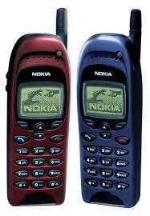
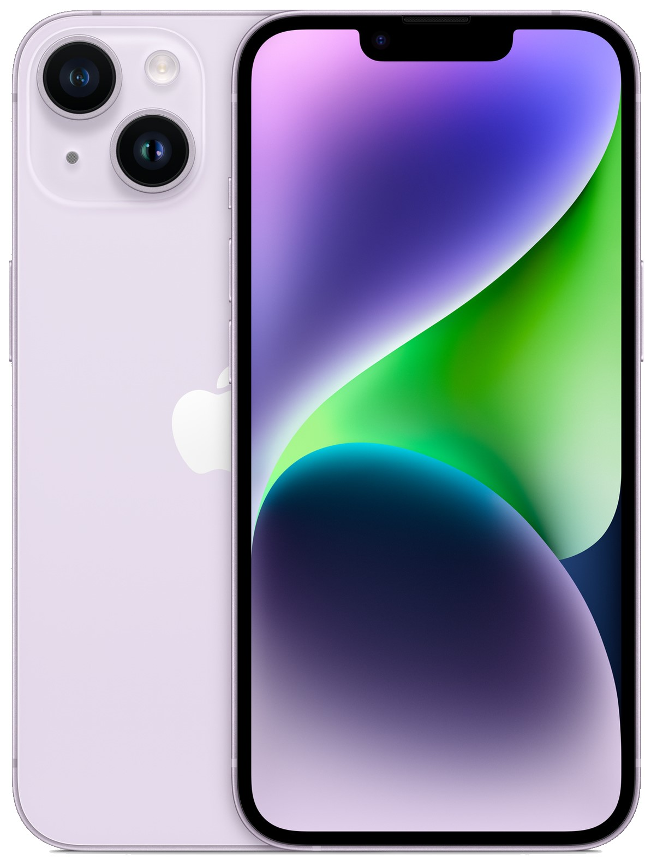
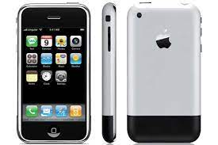
Background
Notes:
The inception of selfies can be traced back to the early days of photography but they have gained significant momentum with the advent of smartphones and front-facing cameras. They've quickly transformed from a trend into a significant part of our global culture.

Slide 4





Background
Selfies have become an integral part of social media, serving as a means of self-expression, identity formation, and a way to communicate with others.
Popular platforms such as Instagram, Snapchat, and TikTok are built on the concept of sharing these visuals, fostering a culture where the selfie is not just a photo, but a powerful tool of personal branding.
Notes:
Nowadays, selfies have become an integral part of social media, serving as a means of self-expression, identity formation, and a way to communicate with others. They're used in various contexts, from everyday moments to global campaigns.
Popular platforms such as Instagram, Snapchat, and TikTok are built on the concept of sharing these visuals, fostering a culture where the selfie is not just a photo, but a powerful tool of personal branding.

Slide 5
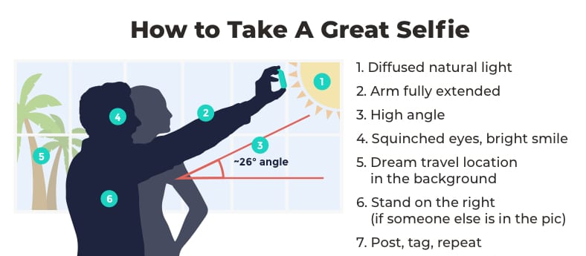
Background
Unflattering angles or expressions
Timing
Notes:
Despite the popularity and a lot of tutorials that helps people take a good selfie, capturing the perfect selfie can often be a challenging task. Most of the issues are the following two:
First is unflattering angles or expressions: It's often hard to simultaneously focus on the phone screen and maintain a natural, attractive expression.
The second one is timing: Capturing a selfie at the right moment, especially when trying to capture a natural smile, can be difficult.

Slide 6


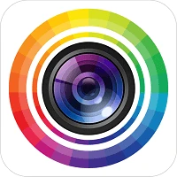
Motivation
Limelight application areas
Lack of functionality to capture selfies based on facial expressions
Many users are in need of such a feature
Notes:
I downloaded several popular selfie apps from the app store including Meitu, Selfie City and Photo Director. I found that none of them had the feature to automatically capture selfies or capture selfies based on expressions. Then, I distributed a questionnaire to citizens, and in the feedback from 200 frequent selfie takers, there is a great need for apps that automatically capture selfies based on expressions. So I think it would be valuable and necessary to develop this new app!

Slide 7
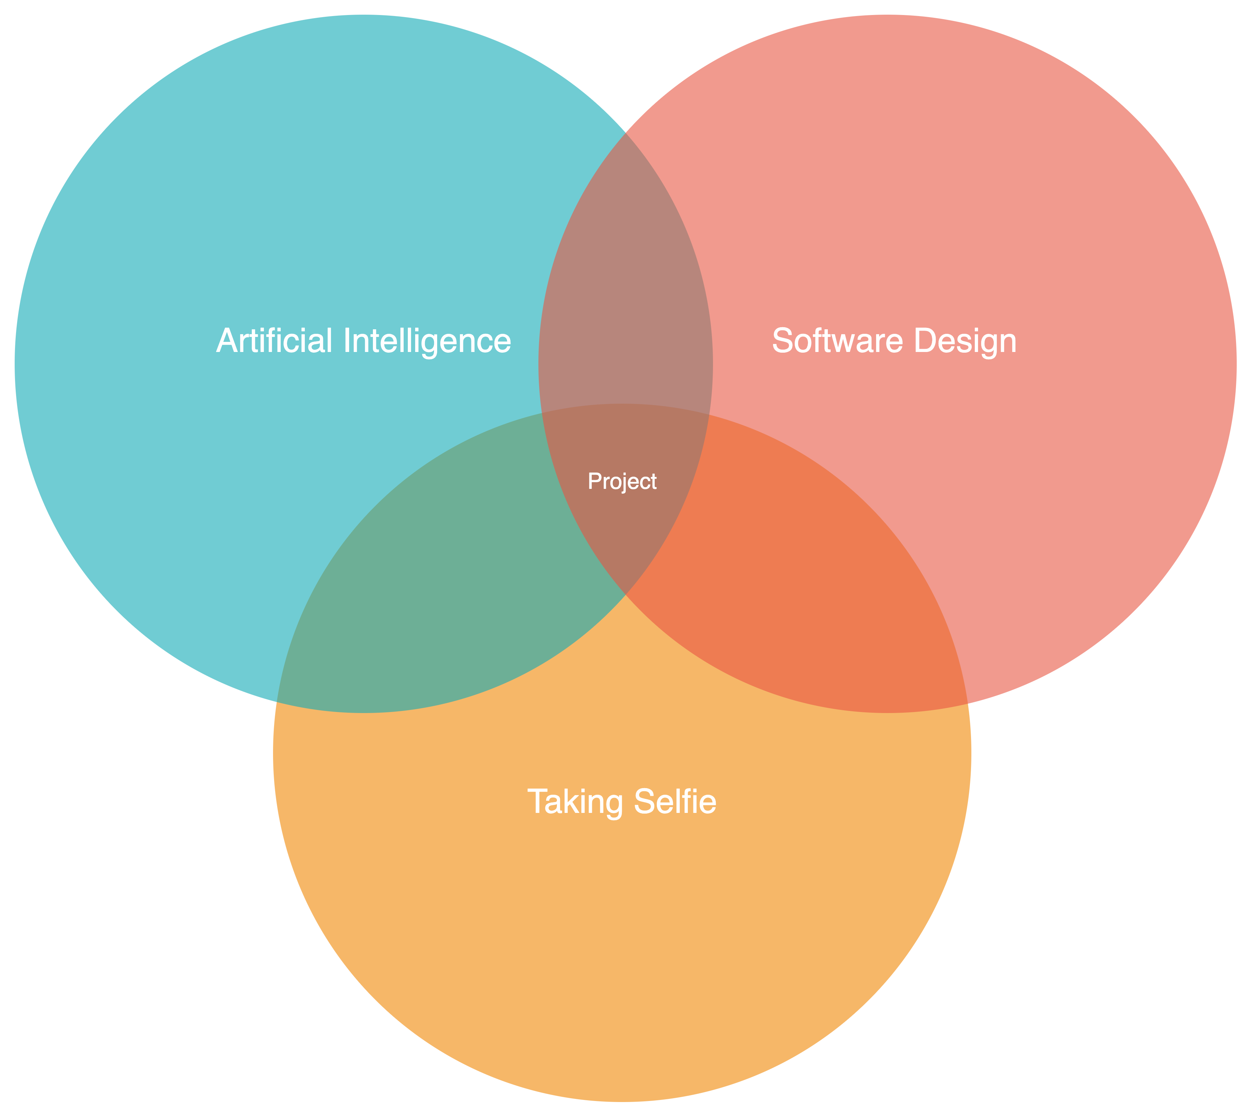
Motivation
What if we integrate them
Notes:
So I wonder what if we leverage facial express recognization model, software development technology to design an app that helps people automatically detect the express and take a selfie.

Slide 8
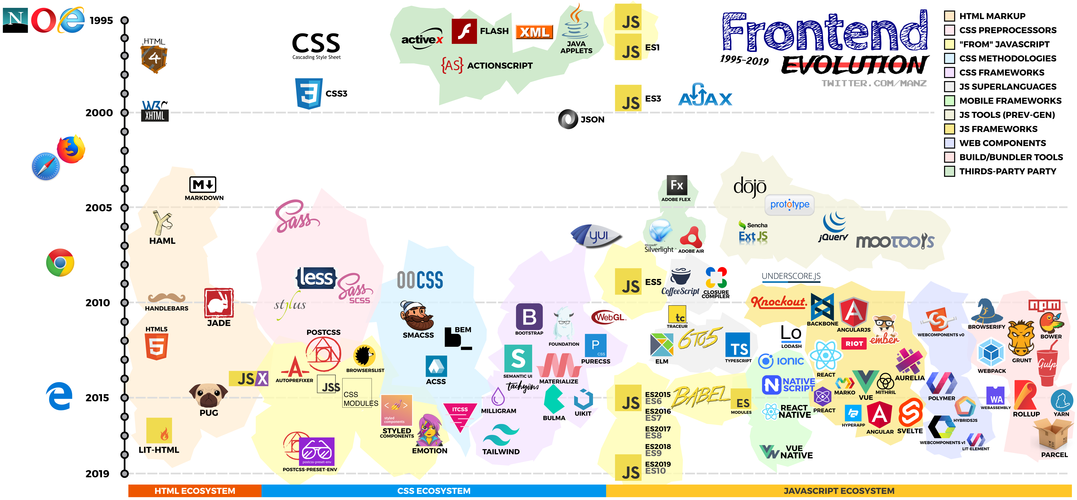
The state of art: Web Development
Notes:
After decades, there are a lot of modern web development tools. For the web framework, there are React, Angular, Vue and so on and some high level framework based on these like Next, Nuxt. A lot of webpack tools too, like vite, webpack.

Slide 9
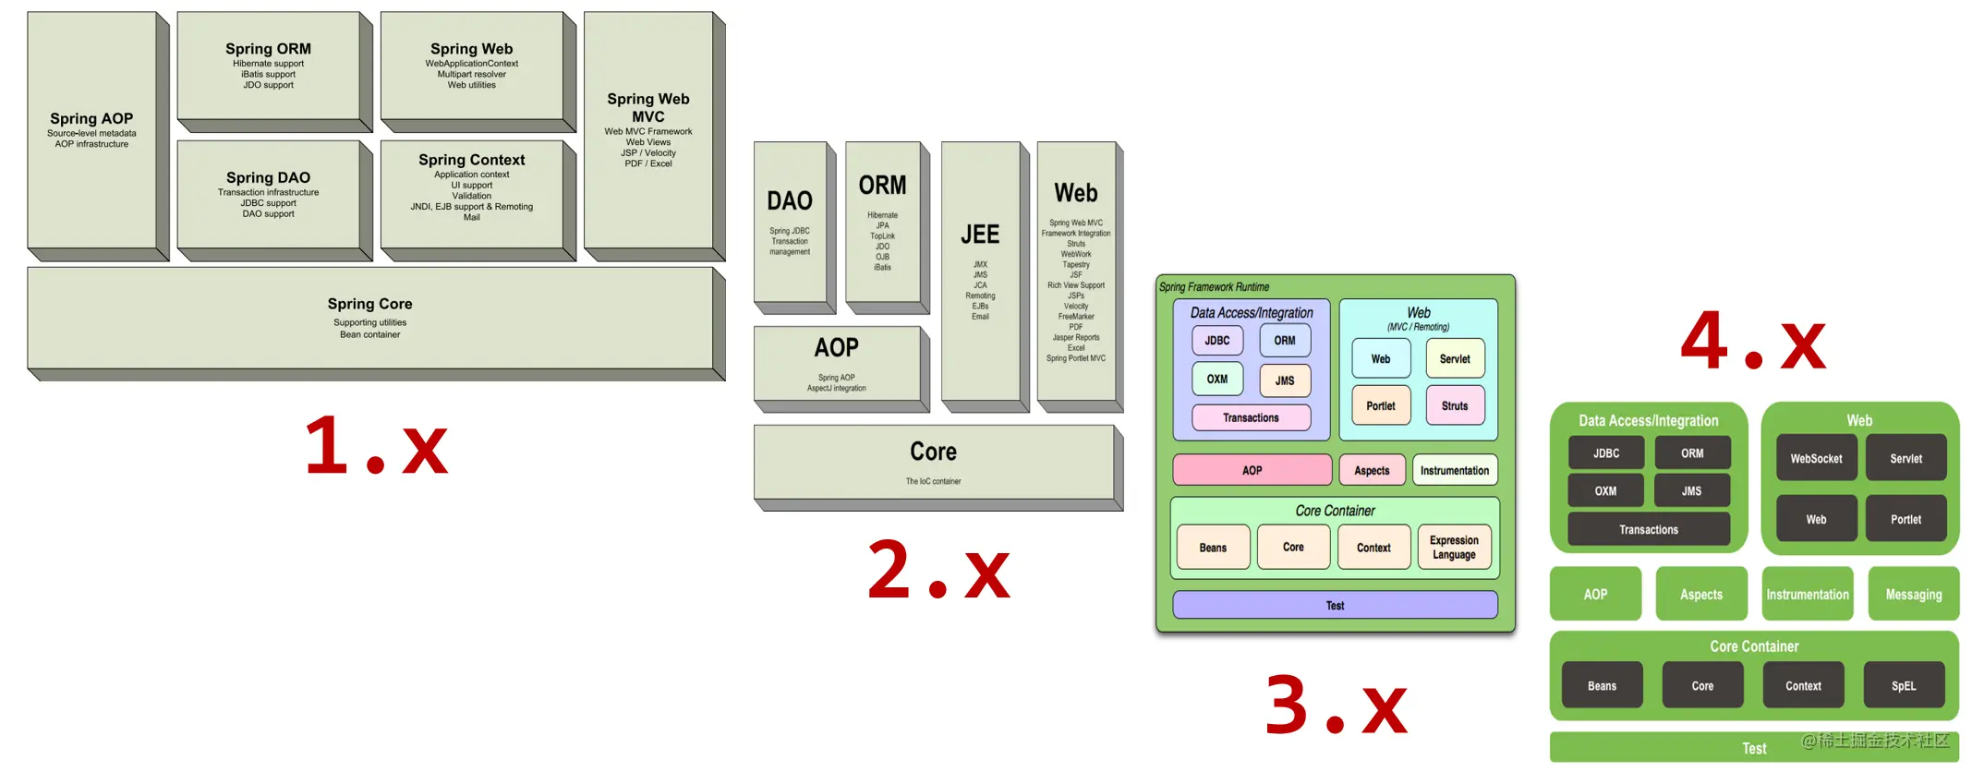
The state of art: Spring Framework
Notes:
Spring framework is the core backend framework for Java and it evolved a lot. Spring 1 introduced core dependency injection and transaction management. Spring added XML namespaces and AspectJ support. Spring 3 brought Java-based configuration, a RESTful web service framework, and Spring Expression Language. Spring 4 supported Java 8, WebSocket messaging, and introduced Spring Boot for standalone applications.

Slide 10
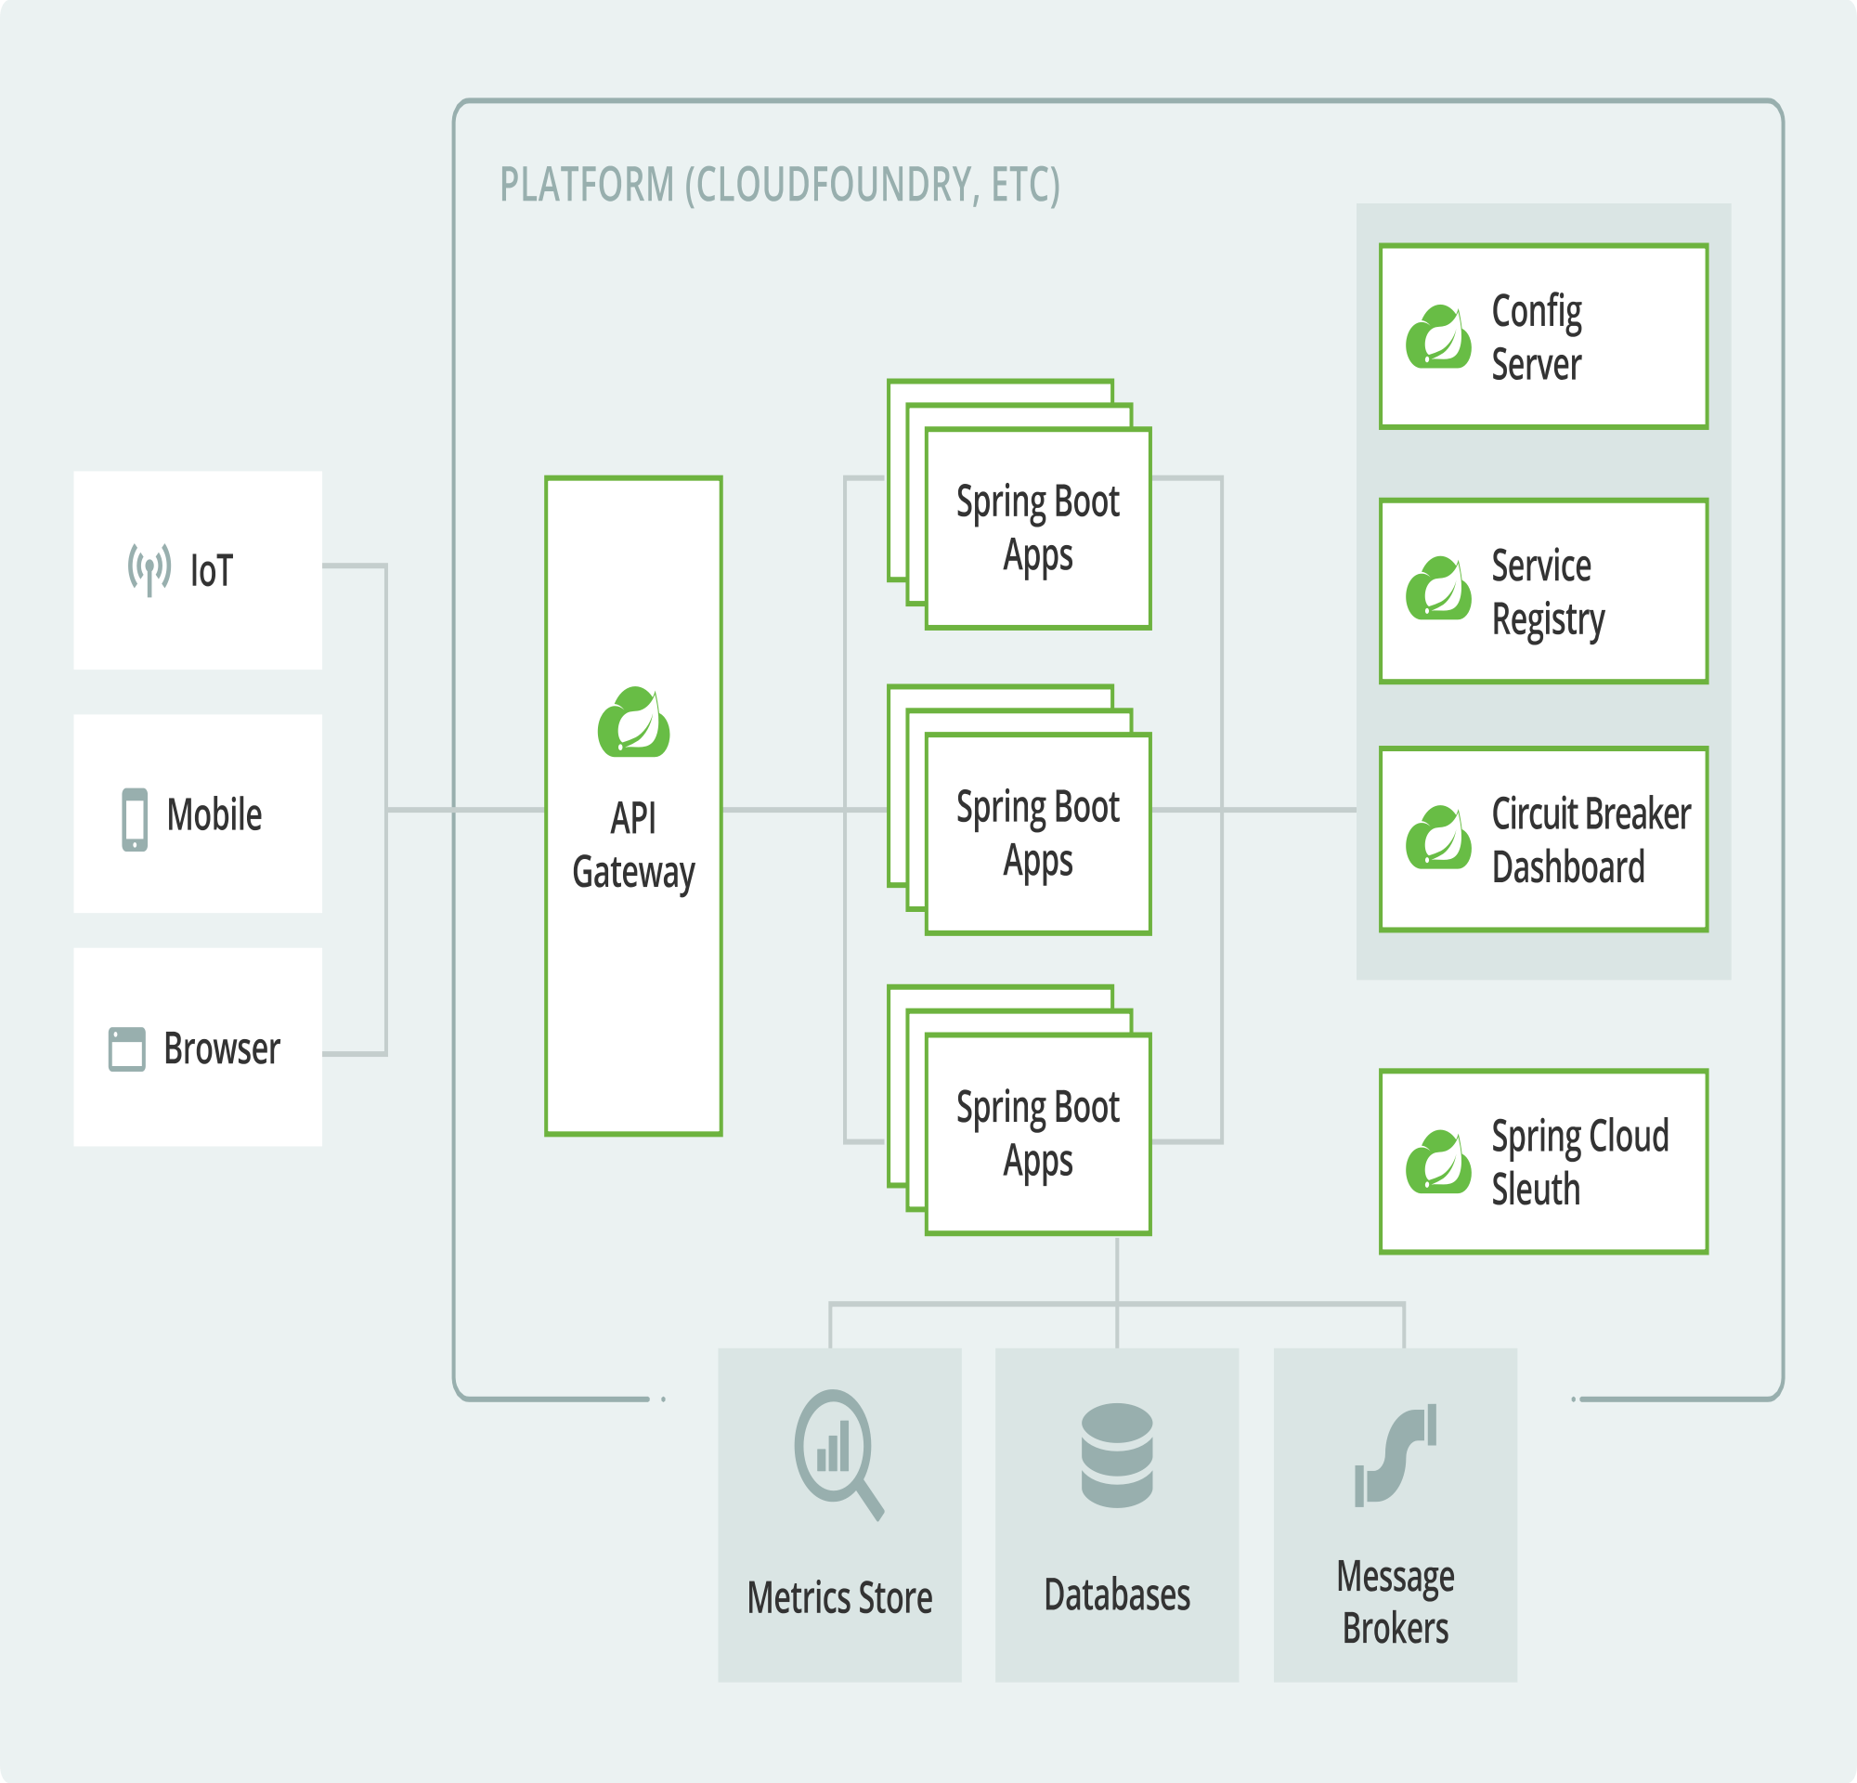
The state of art: Morden Spring
Notes:
Modern Spring introduces Spring Cloud and a mature structure for a large project. The structure usually is spring cloud components like api gateway, service registry, load balancer, CircuitBreaker to make the application high performance and high availability and springboot app cluster to provide services

Slide 11
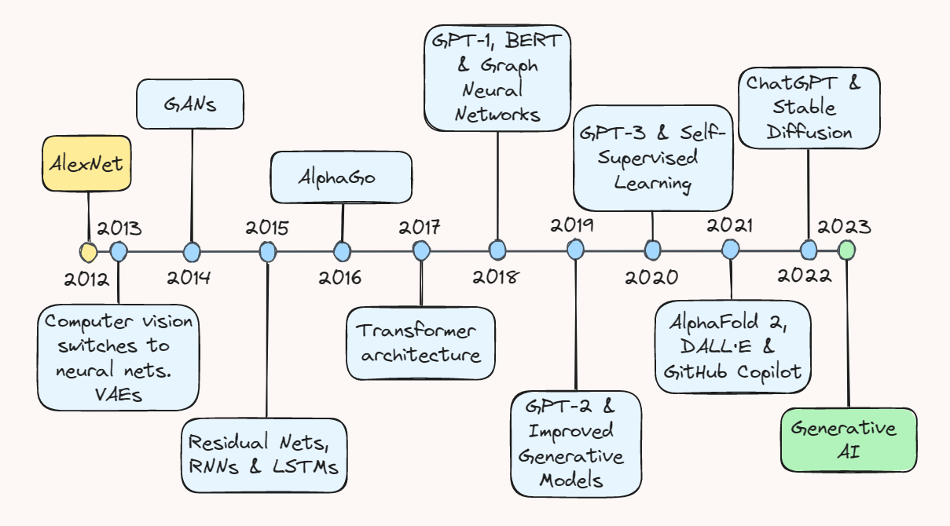
The state of art: Artificial Intelligence

Slide 12



Frontend Design: Framework
Notes:
For the frontend framework, I want to choose from ionic, react native and flutter. React native couldn't build applications for the web, and Flutter's learning difficulty is much higher than Ionic as I need to learn a new programming language dart, which needs a lot of time, so finally choose Ionic. With this framework, I can build an application that can run smoothly on the web, ios and Android, and the performance is good and high security.

Slide 13



Backend Design: Framework

Slide 14
Backend Design: API
 | REST | SOAP | GraphQL | RPC
Format | XML, JSON, HTML, plain text | XML only | JSON | JSON, XML, Protobuf, Thrift, FlatBuffers
Learning Curve | Easy | Difficult | Medium | Easy
Community | Large | Small | Growing | Large

Slide 15
Backend Design: Services
 | Microservices | Monolith | MVC
Scalability | High | Low | Medium
Complexity | High | Low | Medium
Development Speed | Medium | High | High
Flexibility | High | Low | Medium
Fault isolation | High | Low | Medium

Slide 16
Backend Design: Container Orchestration
 | Kubernetes | Docker Swarm | Apache Mesos
Networking | High | Medium | High
Security | Medium | Medium | Medium
Observability | Medium | Low | Medium
Extensibility | High | Low | High
Community | Large | Large | Medium

Slide 17


Backend Design: Facial Expression Recognization
VS
TensorFlow
Face-api.js
Notes:
I found two ways to achieve facial expression recognition. One is using python with TensorFlow. And another one is using face-api.js, which is a javascript library. I choose this library as I can use this library in the front end directly and detect facial expressions, which has little delay and high performance. Otherwise, I need to transfer the real-time video stream to the backend and make a restful API to return the result which will cause significant delay and reduce user experience. But I will still do it to make some comparisons in the paper.

Slide 18
Frontend Implementation
Pages
User Register, Login, Profile
Auto capture selfies
Photo Presentation
Post Bar

Slide 19
Entity Representation for User

Slide 20
Backend Implementation
Built in Java 17
Modules include authentication, authmatically detect an expression and take selfies, photo synchronization, post forum
Split the modules into microservices using Spring Cloud
Spring Boot for Restful API
Infrastructures include AWS S3, Mongodb Altas, Docker, Kubernetes
Backend is entirely decoupled from frontend
Allows for plugging in of different backend modules
Notes:
The backend is built using Java 17, consisting of several modules: authentication, automatic expression detection and selfie-taking, photo synchronization, and forum post functionality. To achieve scalability and flexibility, the modules are split into microservices using Spring Cloud. The Restful API is implemented using Spring Boot, ensuring complete decoupling between the backend and frontend. The system relies on various infrastructures such as AWS S3 for storage, MongoDB Atlas for the database, as well as Docker and Kubernetes for containerization and orchestration, ensuring high availability and resilience. Additionally, the backend allows for easy replacement and upgrade of different modules through pluggable architecture.

Slide 21
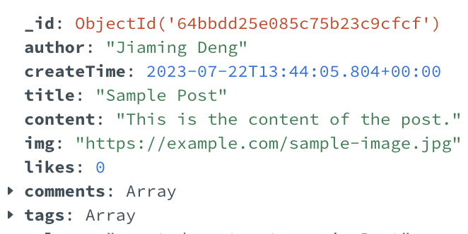
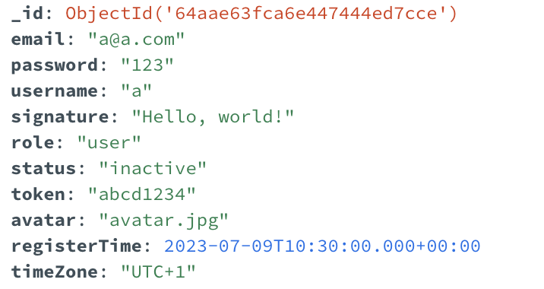
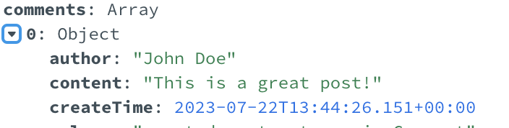
Database Design: Mongodb + Redis
Post
User
Comment
Notes:
For the database design, I designed 3 tables which is post, user and comment. The Post table stores the data people upload in the post bar.The user table stores the data for authentication and user profile. And the comment is the comment to a specific post.

Slide 22
API Design
Authentication: prefix /api/auth
/register, /login, /login_remember
Photo: prefix /api/storage
/upload, /get/all, /get/{username}/{photo_name}
User: prefix /api/profile
/update, /reset_email, /reset_password
Post: prefix /api/post
/create, /update, /delete, /view/{post_id}, /view/tag/{tag}, /view/all, /comment/create, /like, /unlike
Notes:
For the api, it has 4 parts too. for authentication, it could allow users register, login or login with token, so user won’t need to login next time. ...

Slide 23
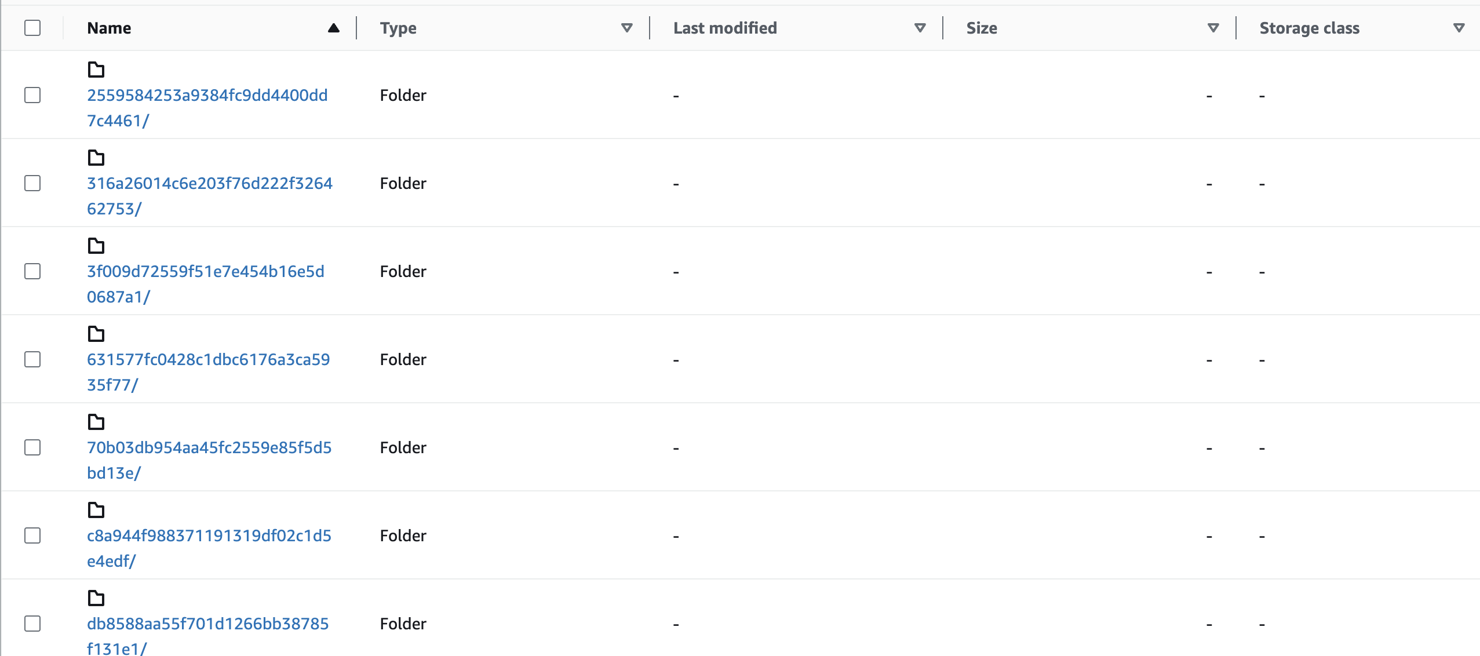
Infrastructure: AWS S3 Storage Buckets
Scalability
Durability and High Availability
Security
Notes:
I choose AWS S3 to store user's photos. AWS S3 provides virtually unlimited storage capacity, allowing seamless scaling to accommodate any volume of user photos. As the user base grows and their photo storage needs increase, S3 automatically scales to meet the demand, without any manual intervention required. S3 stores multiple copies of each object across different data centers, ensuring high availability and durability. AWS S3 offers various security features, including access control lists and bucket policies, allowing you to control who can access the stored photos.

Slide 24
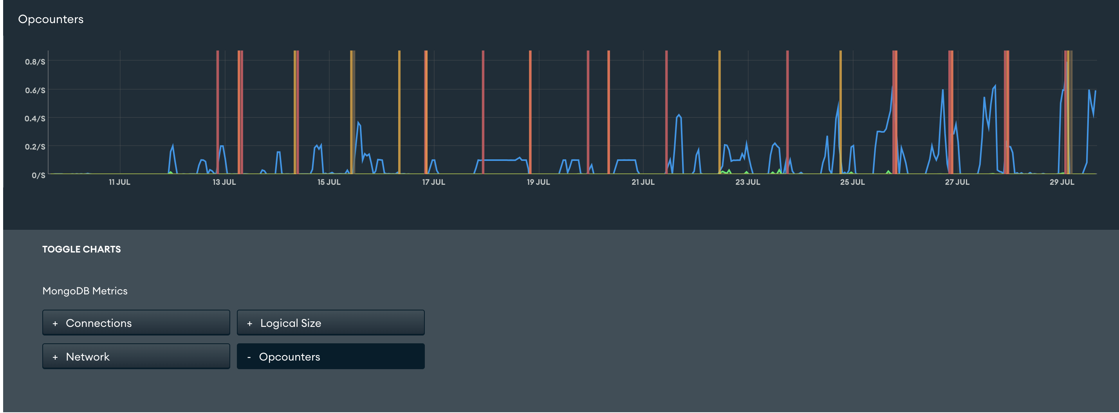
Infrastructure: Altas Mongodb Clusters
Scalability and Performance
Global Data Distribution
Real-time Monitoring and Analytics
Notes:
MongoDB Atlas allows seamless horizontal scaling to accommodate growing data and user loads. It can also support data replication across multiple regions and cloud providers, enabling low-latency access for users worldwide. I can also get the real-time motitoring and analytics to proactively address potential issues and optimize the performance of your authentication and user profile services.

Slide 25
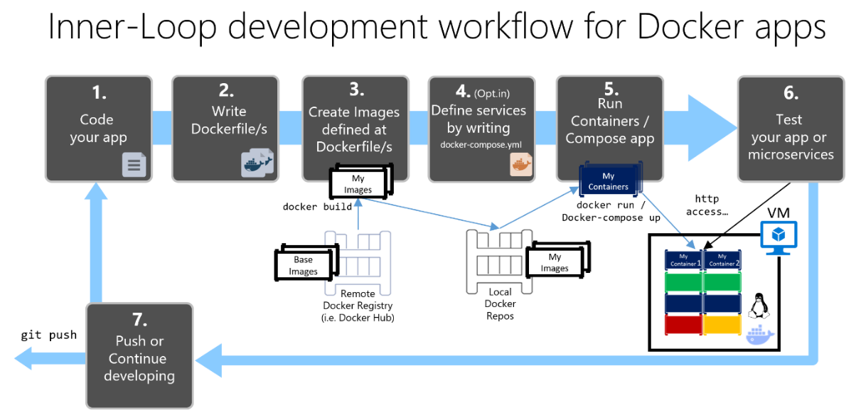
Infrastructure: Docker
Basic Docker images containing all of microservices
Docker overlay network to connect all docker nodes together
Notes:
I used Docker-based microservices architecture. I used basic Docker images to package each microservice, and a Docker overlay network is employed to connect all the Docker nodes together. I have also followed the Docker app development workflow.

Slide 26
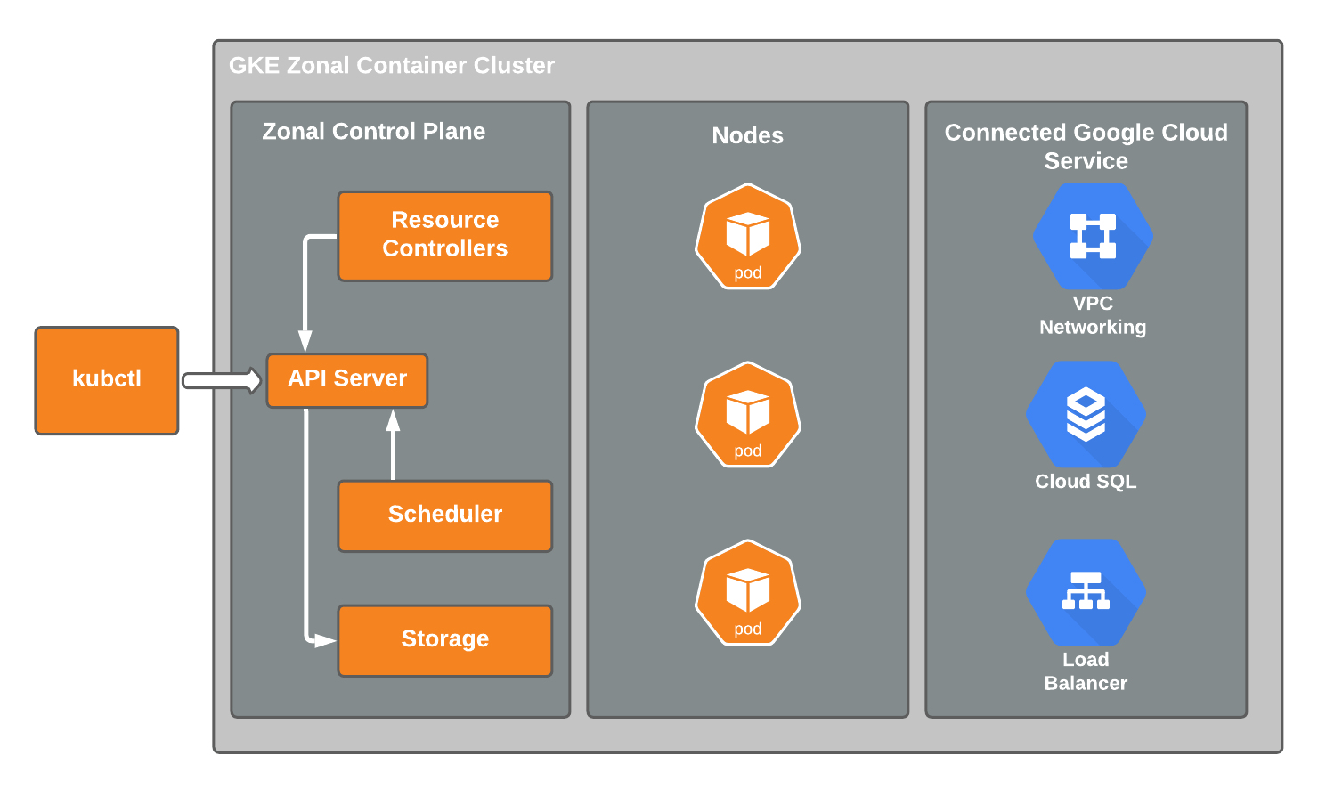
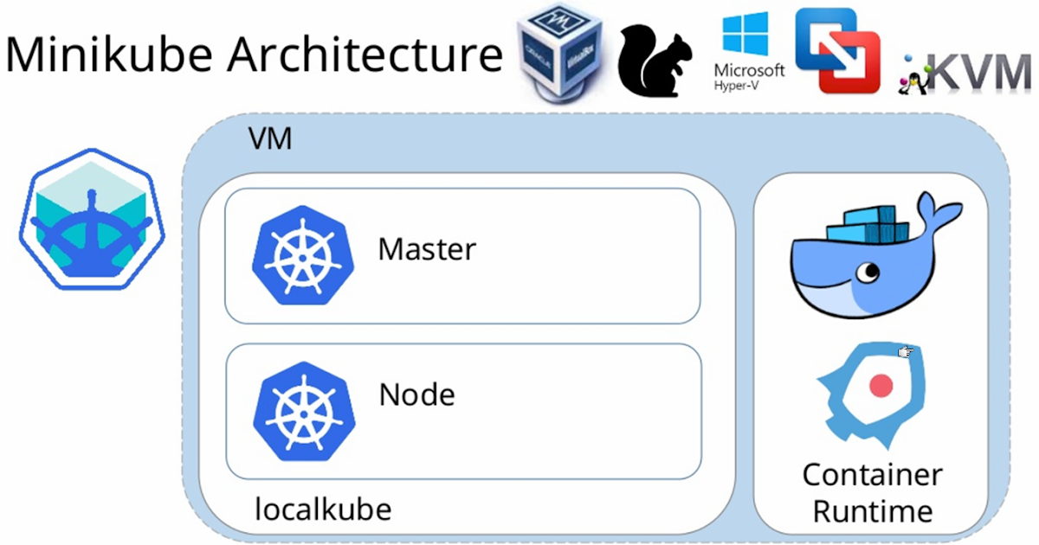
Infrastructure: Kubernetes
VS
Google Kubenetes engine
minikube
Notes:
To choose a suitable platform for kubernetes engine, I compare the google kubenetes engine with minikube. At this stage, my main work is make sure the application run smoothly and test the performance, so I don’t need large scale of kubenetes clusters. I choose minikube finally which is easily deployed in my machine and has the same functionalities of gke.

Slide 27
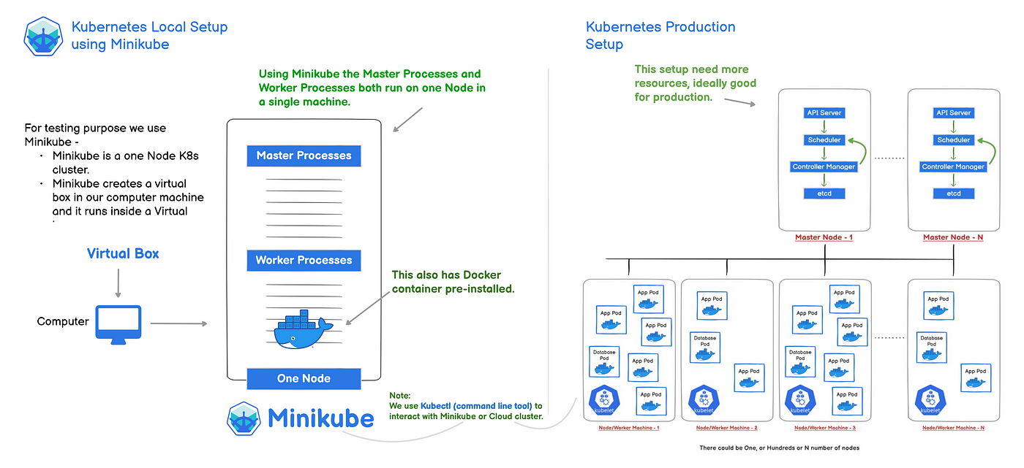
Infrastructure: Minikube
Notes:
This is how minikube runs, I use docker as container that kubernetes uses it to build each app pod, and I can scale it automatically according to the memory usage or specify the number of replicates.

Slide 28
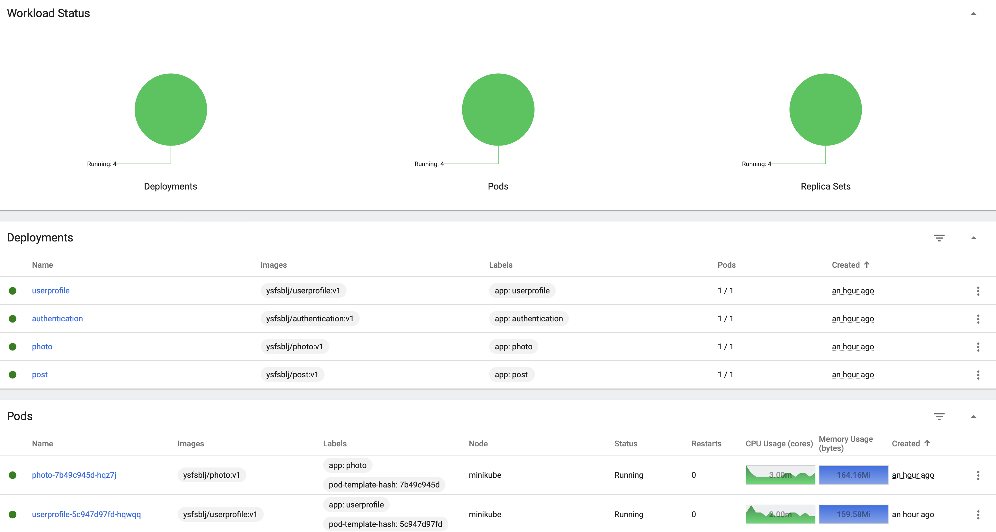
Infrastructure: Minikube

Slide 29
Deep learning: Face-api.js
Real-time webcam video stream
Face Detection
Facial Expression Analysis
+ 一张图我微笑
Notes:
1. Using the mediadevices api from phone or browser.
2,3. use the face-api’s api const detectionsWithExpressions = await faceapi.detectAllFaces(input).withFaceLandmarks().withFaceExpressions()

Slide 30
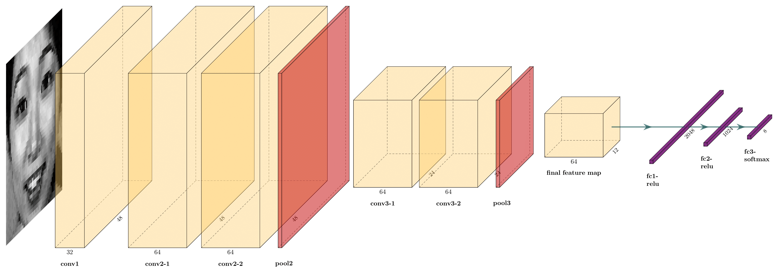
Deep Learning: Dataset and Model
Training Dataset: Fer2013, Jaffe and CK+
Face Detect: Google BlazeFace Algorithm
Feature Extraction and Classification: Traditional CNN
Notes:
Fer2013, Jaffe and CK+ all contains 7 facial expressions including angry, disguest, fear, happy, sad, surprise, neutral.

Slide 31
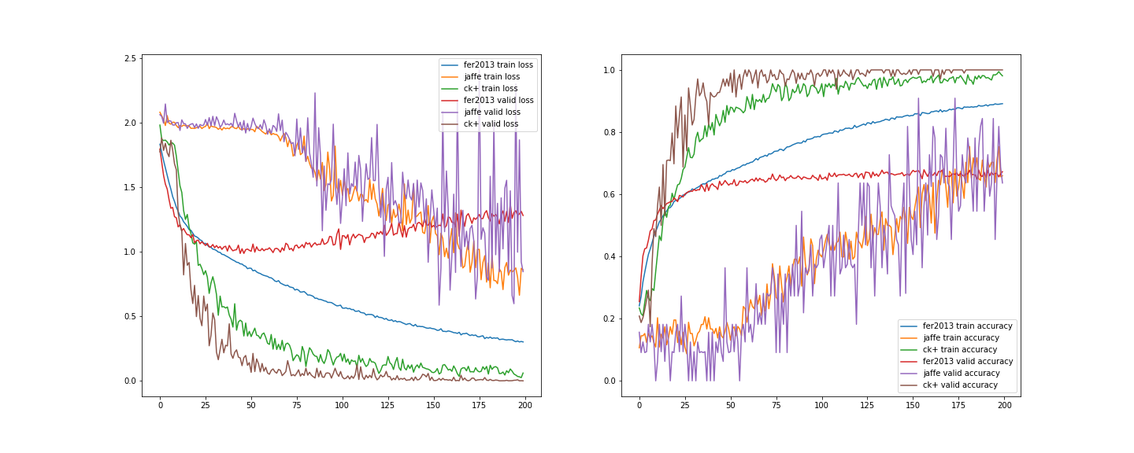
Deep Learning: Training
Notes:
Finally, on FER2013, both the training set and the test set achieved an accuracy rate of about 67%, because the crawler collection of this data set had problems such as label errors, watermarks, and animated pictures. JAFFE and CK+5-fold cross-validation both reached an accuracy rate of about 99%.

Slide 32
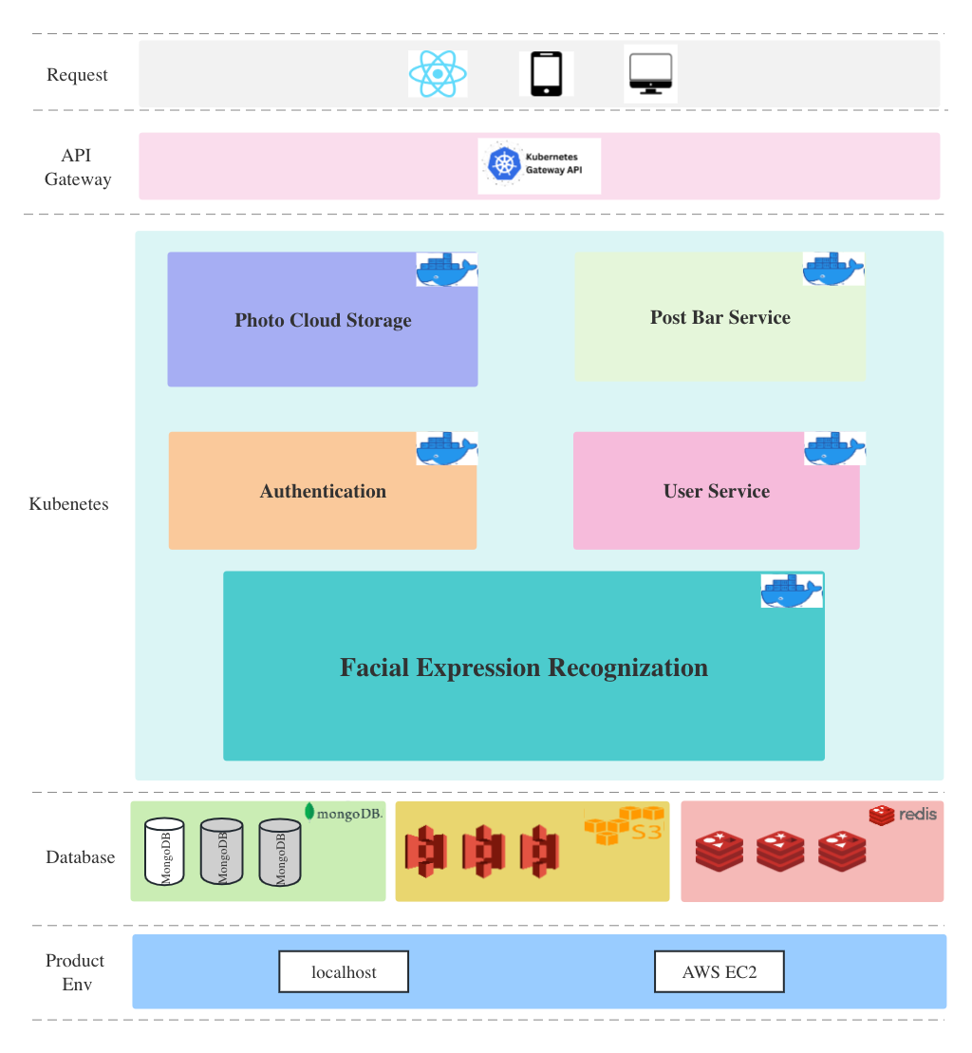
Project Structure

Slide 33
Demo: Authentication

Slide 34
Demo: Automatically detect smile

Slide 35
Demo: Detect other expressions

Slide 36
Demo: Photo Sync

Slide 37
Demo: Post Bar

Slide 38
Test

Slide 39
Conclusion
Frontend:
Ionic: Build cross-platform mobile applications for web/android/iOS, etc.
TypeScript: A strongly typed programming language based on JavaScript, better tooling at any scale.
Backend:
Spring Boot: Develop Restful API
Spring Cloud: Implement microservices
Kubenetes: Container orchestration
AWS S3: Cloud db for multimedia file
Face-api.js: Facial expressions recognization
MongoDB: Nosql db for user, post and comment data storage
Redis: Memory db for cache
Notes:
So all in all, for the frontend, I used ionic to build cross platform mobile applications. For the backend, I used springboot to develop restful API, ...

Slide 40
Future work
Enhanced User Experience
Security and Privacy Measures
Performance Optimization
Notes:
Firstly we can enhance user experience. For example we can explore user behavior analytics to gain insights into user preferences and improve app usability and introduce personalized content recommendations based on user interactions and preferences. Secondly, I will add Security and Privacy Measures. maybe Implement end-to-end encryption to protect sensitive user information during transmission.
Finally, performance optimization is also very important to do. Optimize API endpoints and database queries for improved response times and reduced latency and implement content delivery networks (CDNs) to enhance media file delivery speed and reduce server load.

Slide 41


Thank You !
Trinity College Dublin, The University of Dublin _{Dissertation presentation}

Slide 42
Questions ?
Trinity College Dublin, The University of Dublin _{Dissertation presentation}

